Slide 1


X
Jubelio
Final Task Quality Assurance Jubelio
Jubelio Quality Assurance Engineer Project Based Internship Program
Presented by
Regina Putri Wanda Zahirah

Slide 2


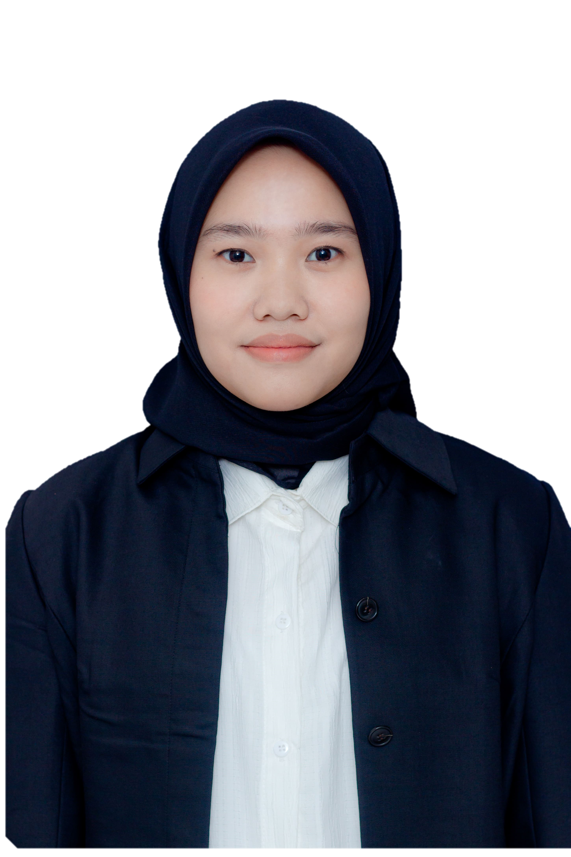
Regina Putri Wanda Zahirah
Experience
UI/UX Design Intern
PT. Cazh Teknologi Inovasi
A fresh graduate in Informatics Engineering from Institut Teknologi Telkom Purwokerto. Have interest in Quality Assurance. Currently taking Rakamin Project Based Virtual Internship Quality Assurance Jubelio and Quality Assurance Course in MySkill E-Learning.
Quality Assurance
Virtual Internship Jubelio

Slide 3
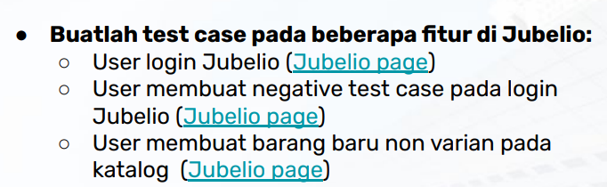
Case Study

Slide 4
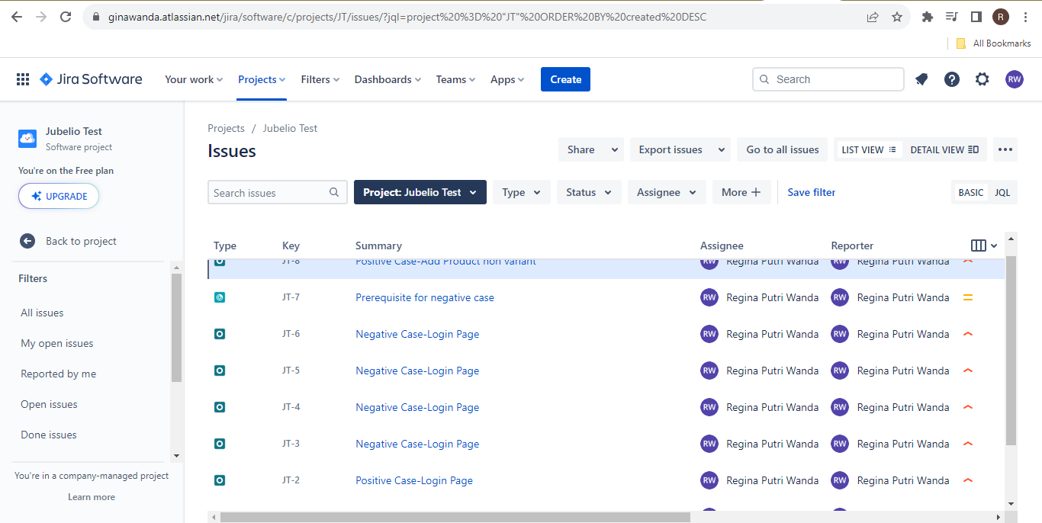
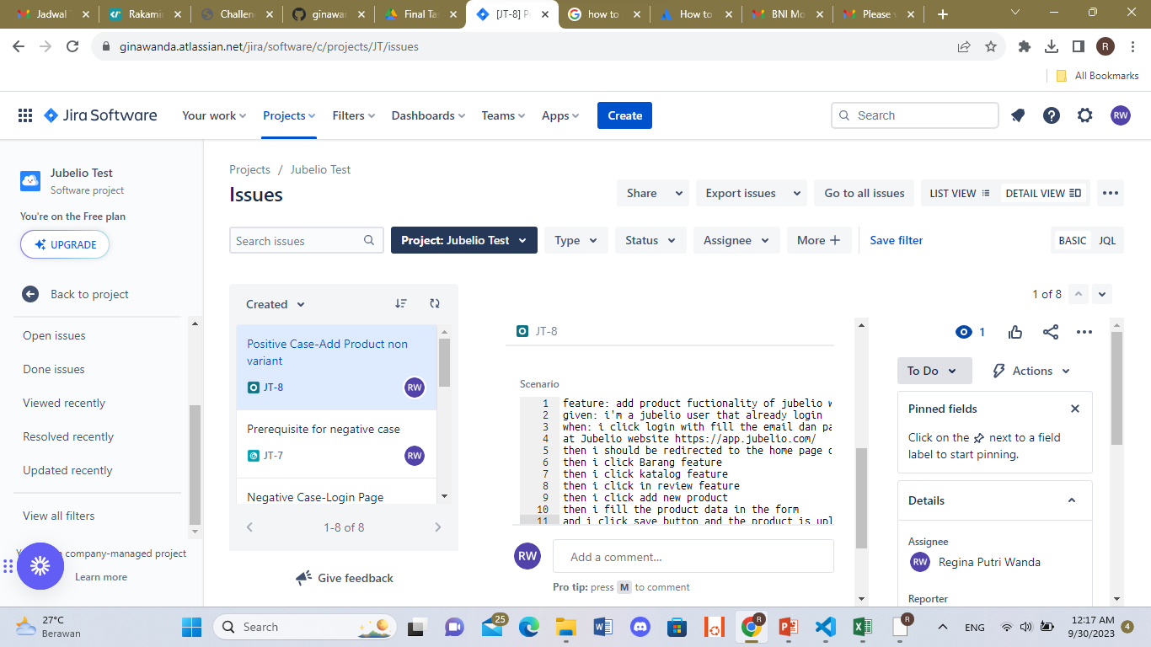
Result
Test case dibuat Menggunakan Jira dan menambahkan Xray di jira

Slide 5
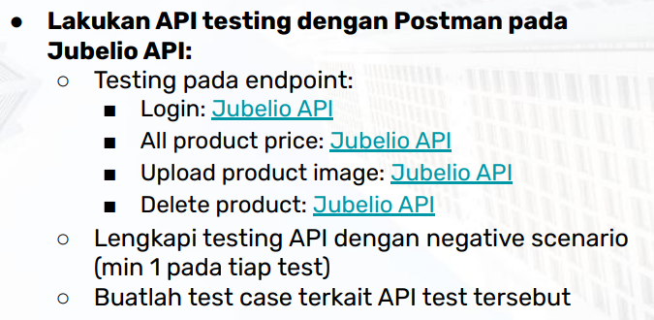
Case Study

Slide 6
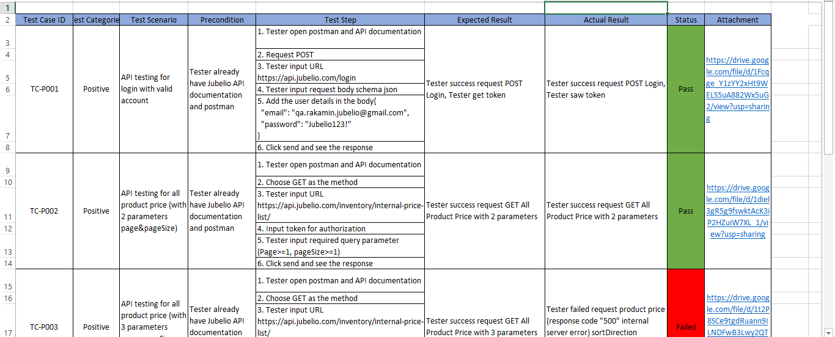
Result
Hasil test API : https://drive.google.com/drive/folders/1W109g8NeiZfLF6DsdYRJbRyMBog5AF94?usp=sharing

Slide 7
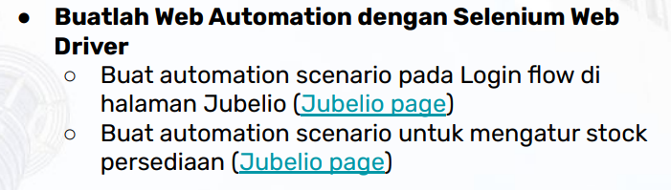
Case Study

Slide 8
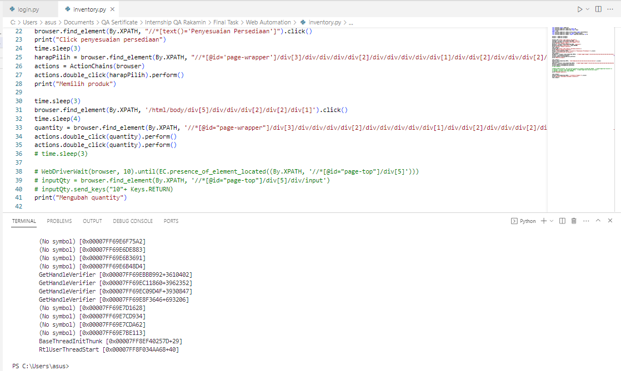
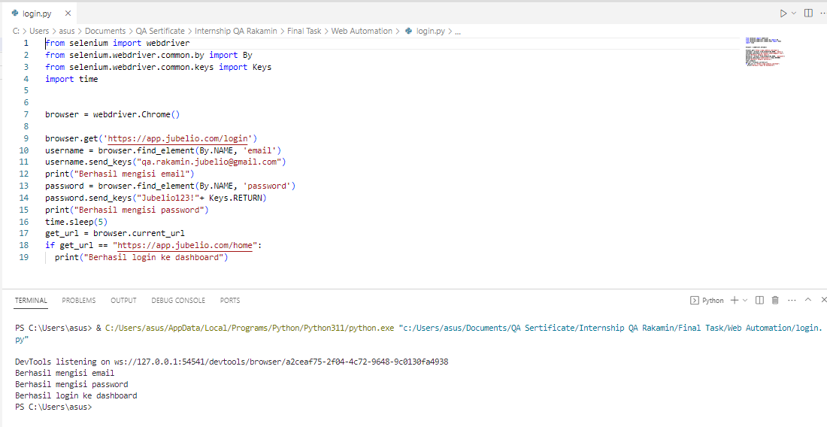
Result
Web Automation:
https://drive.google.com/drive/folders/1q6nMr_oHJEdDhhk7Ssm2Y4al_ADhhx0e?usp=sharing

Slide 9
Links
Jira:
https://id.atlassian.com/invite/p/jira-software?id=zh3PuMdISh69lBxhXdpsUw
Google Drive:
https://drive.google.com/drive/folders/1s0wFOE6nw6ZlVwGkGx0RT8SJ0fgg-EAi?usp=sharing
Video Presentation:
https://drive.google.com/file/d/1Lpg9e_-wus-vJN2oHVLO4tdU8G0KThkv/view?usp=sharing
GitHub:
https://github.com/ginawanda/QAJubelioRakamin

Slide 10
Video Presentation Here
https://drive.google.com/file/d/1Lpg9e_-wus-vJN2oHVLO4tdU8G0KThkv/view?usp=sharing

Slide 11
Thank You
X
Jubelio

